Slide 1





Prediksa
Presented By
Group 13
Company
Heart Disease Classification
for Insurance

Slide 2



Our Path
Prediksa
&
Company
The Story Behind It
Mar-May 2025
May 2025
June 2025
June 2025
Idea Formation--RnD Process
Prototype Development
MVP Launch
Pilot Testing
Prediksa was developed between March and June 2025 as a capstone project for Mathematical Machine Learning course. The project began with identifying the urgent need for early detection of cardiovascular risk in Indonesia. The team designed the system architecture, collected relevant datasets, and built a machine learning-based prototype using ensemble methods. A functional Minimum Viable Product (MVP) dashboard was also created to visualize individual risk predictions. While still in its early academic phase, Prediksa shows strong potential for real-world application and future collaboration with healthcare and insurance sectors in the future.

Slide 3






Team
Prediksa
Company
Members
Fitri Cahyani
Leader
Ashabrina N
Indara N
Valina Putri
M. Adzin Rosiq
Manager
Data Analytics
Data Engineer
Business Analytics

Slide 4



Problem
Prediksa
Company
Statement
The Urgent Need for Early Cardiovascular Risk Prediction
Rising National Health Burden
Cost-Effective Solutions
In 2022, the Indonesian government spent over Rp15.37 trillion (US$983M) on heart and stroke treatments under the national health insurance scheme (JKN), signaling a heavy reliance on late-stage intervention.
A 2025 study in the Journal of National Institute of Health showed that cardiovascular risk prediction using big data and machine learning is more accurate and less costly than traditional methods.
Top Contributor to Insurance Claims
Heart Disease is Growing, Yet Often Detected Late
In 2023, heart disease was among the top 5 causes of life insurance health claims, leading to growing financial pressure for both public and private insurers.
The prevalence of heart disease rose from 1.5% (2018) to 2.2% (2022), based on Riskesdas data — many patients are unaware of their condition until it becomes critical.
Resource : https://shorturl.asia/UZGva
Resource : https://shorturl.asia/UZGva

Slide 5


Prediksa
Our Objective:
Company
Empowering Prevention Through Predictive Technology
To develop an AI-powered system that predicts individual risk of cardiovascular specifically heart disease.
Develop a machine learning model capable of early detection of heart disease risk, enabling companies to make strategic decisions in insuring clients.
To enable smarter, data-driven decision-making for insurer stakeholders
To minimize national and insurer healthcare costs
*Resource:
https://www.ahajournals.org/doi/10.1161/CIR.0000000000001258

Slide 6





Process Flow
The applicant submits the required administrative documents and medical data.
The model runs and analyzes the patient's data.
Result: Risk or no risk with a percentage.
Registration
Data Input
Results
Administration
Model Analysis
The data is used to assess potential risks, which will then be used to calculate premium policies and decide whether to approve or deny the applicant’s submission.
The potential client registers themselves.
The data is input into the system for analysis using the machine learning model.

Slide 7


The data is input into the system for analysis using the machine learning model.
Model Building
Model | Accuracy Cross-Validation
SVM | 0.8841
Random Forest | 0.8768
Logistic Regression | 0.8549
Soft Voting | 0.8878
Hard Voting | 0.8829
Stacking | 0.8854
Logistic Regression
Decision Tree
Random Forest
Support Vector Machine (SVM)
K-Nearest Neighbor (K-NN)
Ensemble Learning
Soft Voting Classifier
Hard Voting Classifier
Stacking Classifier
So, the best model to use in prediction is the soft voting ensemble model.

Slide 8
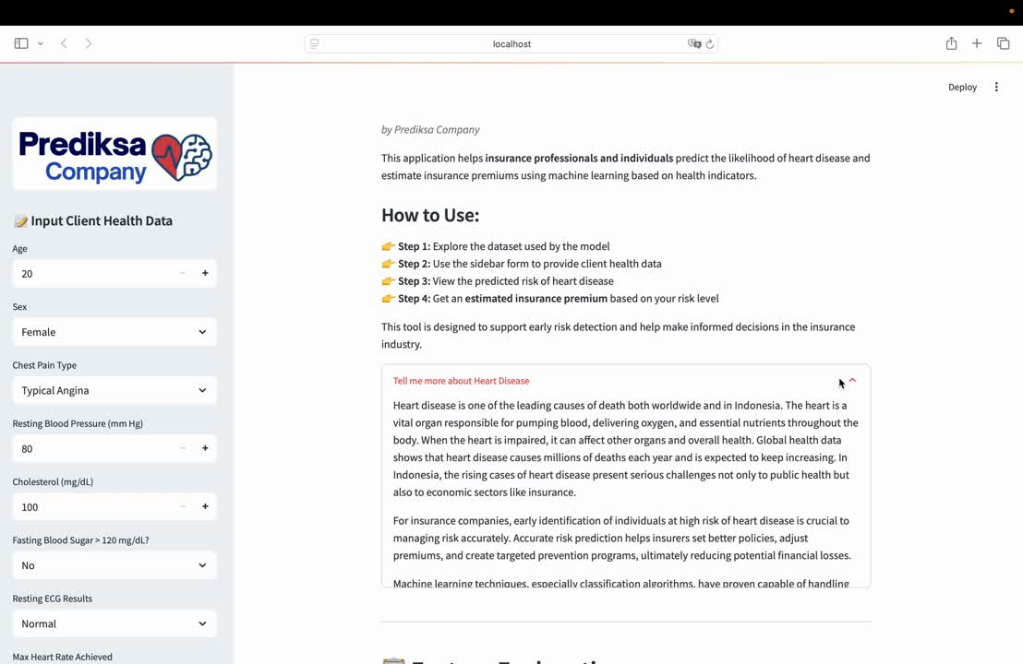



Output
Prediksa Dahsboard

Slide 9
Prediksa
Company
Key Next Steps
Limitation
Expanding data sources by using additional datasets from more diverse sources such as WHO, CDC, local hospitals, or other medical platforms.
Data limited to Kaggle (heart disease dataset).
Observed features focus only on standard medical data.
Enhance feature diversity by incorporating lifestyle factors, socio-economic indicators, and family medical history to build a more comprehensive prediction model.
Geographic scope limited to 4 cities
(Cleveland, Hungaria, Swiss, Long Beach V)
Expand coverage to more diverse regions/populations.
Observation period is outdated (1988).
Using more recent data to reflect current heart disease conditions and trends.
Data users focused only on insurance industry.
Expanding cross-sector use and adapting the model to detect other common diseases for broader medical use.

Slide 10

Prediksa
Conclusion
Company
Our machine learning-based heart disease calssification solution helps insurance companies:
Enhance risk assessment accuracy efficiently
Reduce long-term claim costs through early intervention
Promote proactive health prevention among clients
Future Plans
Validate the model with external dataset
Improve model interpretability
Develop an interactive dashboard
Build stategic partnerships with insurers
Thank You

